Slide 1
Speech Recognition System
Submitted By:
BHAWNA AGARWAL- 102103273

Slide 2
Need Analysis
Speech recognition is the method of conversion of language spoken by the user to text and use it for various other functions.
Python is a popular programming language to implement this as it is simple,versatile and has rich ecosystem of libraries. Principles of Speech Recognition:
In the first step audio data input is collected to train the speech recognition model. The relevant features from this data are collected to train the machine learning model.
Once model is trained, it can be used to recognise new audio data input and errors are corrected from the text transcription.

Slide 3
Platforms
VS code | It is a free-editor that helps programmers to write code and helps in debugging and correct the code using intelli-sense method.
speech_recognition | Library to recognize speech input from the user and open a website in the default browser based on the recognized input. The library can be installed using pip and requires PyAudio to be installed as well.
pyautogui | It is cross platform GUI automation Python module for human beings. It is used to programmatically control mouse and keyboard of the device.

Slide 4
Objective
The objective of this project is to open a website using speech recognition using python.The data input can be in the from of audio recordings or live audio input. The libraries required are speech_recognition and PyAutoGUI.
The microphone is set up and a speech recognizer object(r) is initialized and audio is listened to by the use of functions like recognizer(), listen() of speech_recognition package module.
The speech is recognized with google using recognize_google() and recorded.
The PyAutoGUI then attempts to open chrome by pressing windows key first and open chrome and write the website on the chrome using write function of this module. To display the data on the screen, the recorded data is saved to a wav file and used as an input and the text is displayed on the screen.

Slide 5
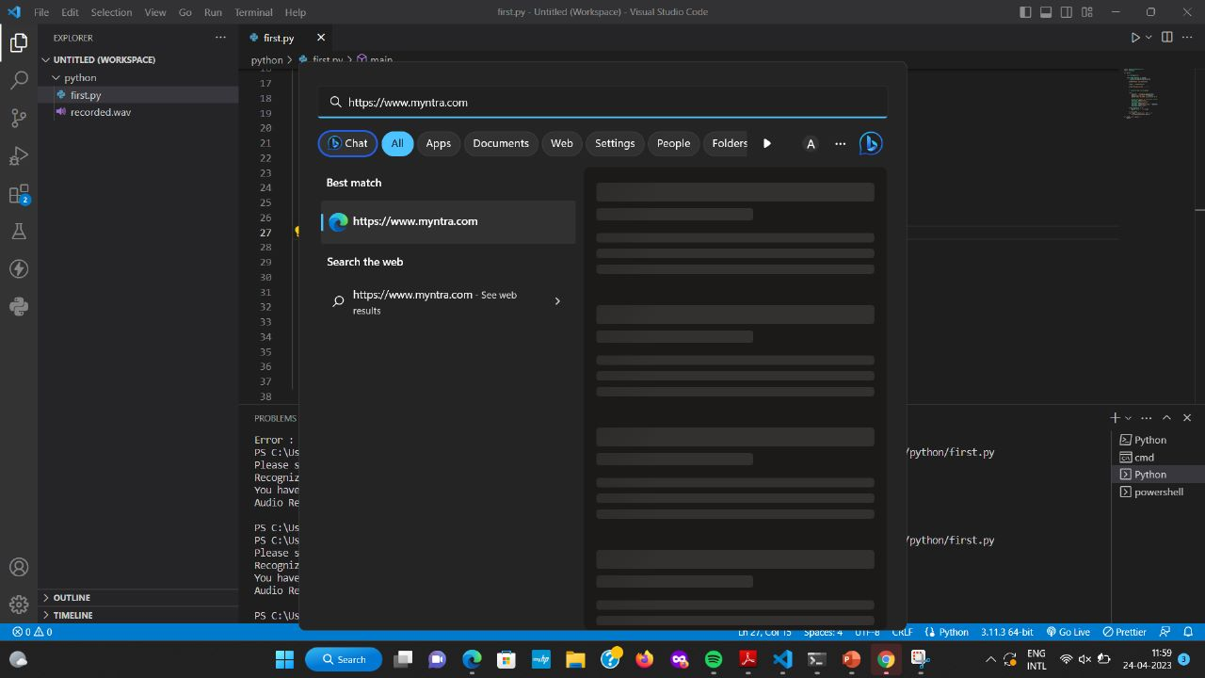

Results

Slide 6
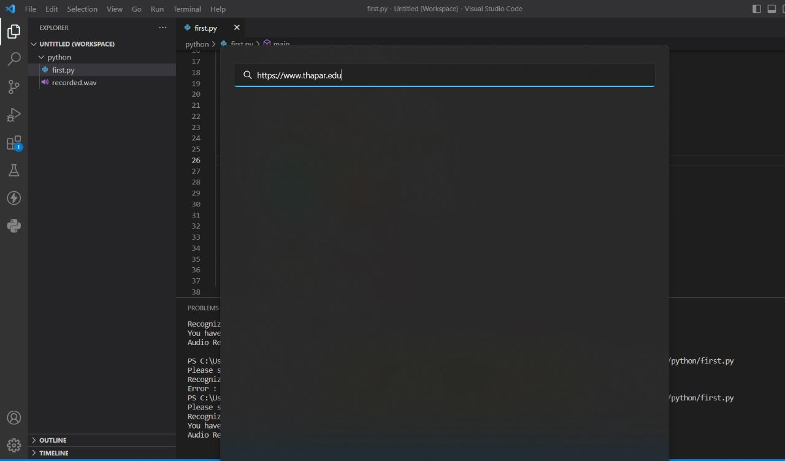
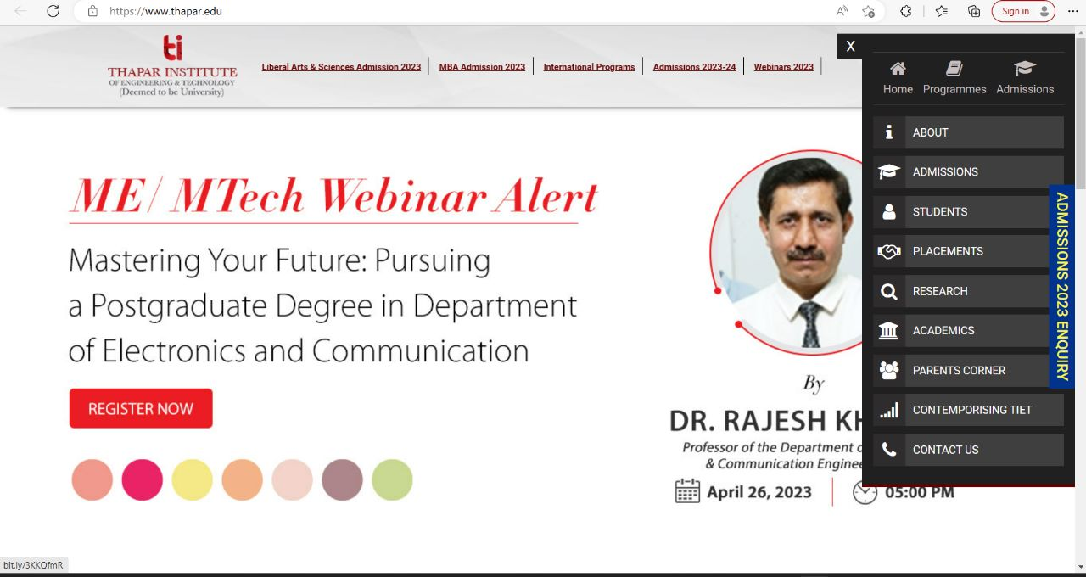
Results

Slide 7
Impact of the work
By this project, we have created a python program to recognize the audio speech input of the user and use it open websites by controlling the mouse and keyboard of the device even without manual input by user. This technology has wide range of applications in today’s world like:
Virtual Assistants- Siri, Alexa, Google Assistant and others.
Dictation Software- Used to develop dictation software that converts spoken words into text.
Language Translation- Used to convert spoken words from one language to another.

Slide 8
Conclusion
In conclusion, voice recognition is a critical application of AI that enables machines to understand and interpret human speech.
It has numerous practical applications in various industries, including virtual assistants, dictation software, customer service, language translation etc.
As the AI technology continues to improve, we can expect voice recognition to become even more accurate and versatile. It will create growth of the conversational AI as well.

